Slide 1




Economic outlook for the EU and Slovakia: Why Recovery Plan?
Zdeněk Čech
Head of Economic Analyses Section
European Commission Representation in Slovakia

Slide 2
Outline
1/ European Commission‘s Winter 2021 Economic Forecast
2/ Slovakia‘s macroeconomic outlook and EU‘s Recovery plan

Slide 3
THE COMMISSION WINTER 2021 FORECAST

Slide 4
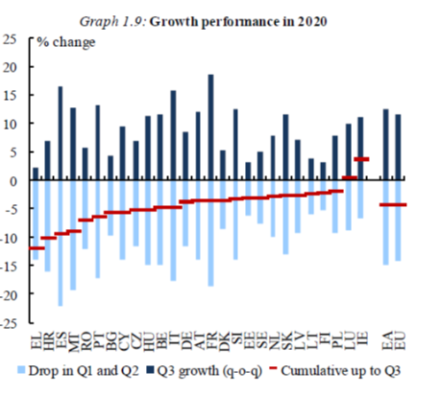
EU economy hardly hit by COVID-19 in early 2020

Slide 5
The global economy is bouncing back
Global PMIs
Global and EU Trade

Slide 6
Sectoral divergences persist in Europe
Sectoral survey data, euro area

Slide 7
Labour markets continue showing signs of resilience
Unemployment rate

Slide 8
A challenging start into 2021, but vaccinations provide a hope…
EU GDP is now forecast to grow by about 3.7% this year and 3.9% in 2022 after a contraction estimated at 6.3% last year.
Near-term developments remain challenging due to ongoing necessary restrictions
Vaccinations to support return to growth from the spring, faster recovery thereafter
Member States set to recover at an uneven pace
Uncertainty and risks to the outlook remain high
Potentially significant GDP boost from Next Generation EU not yet factored in

Slide 9
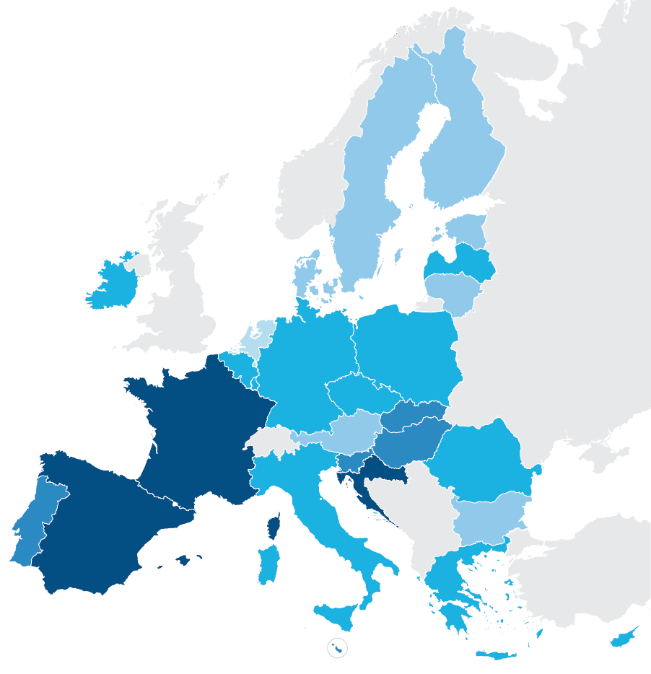
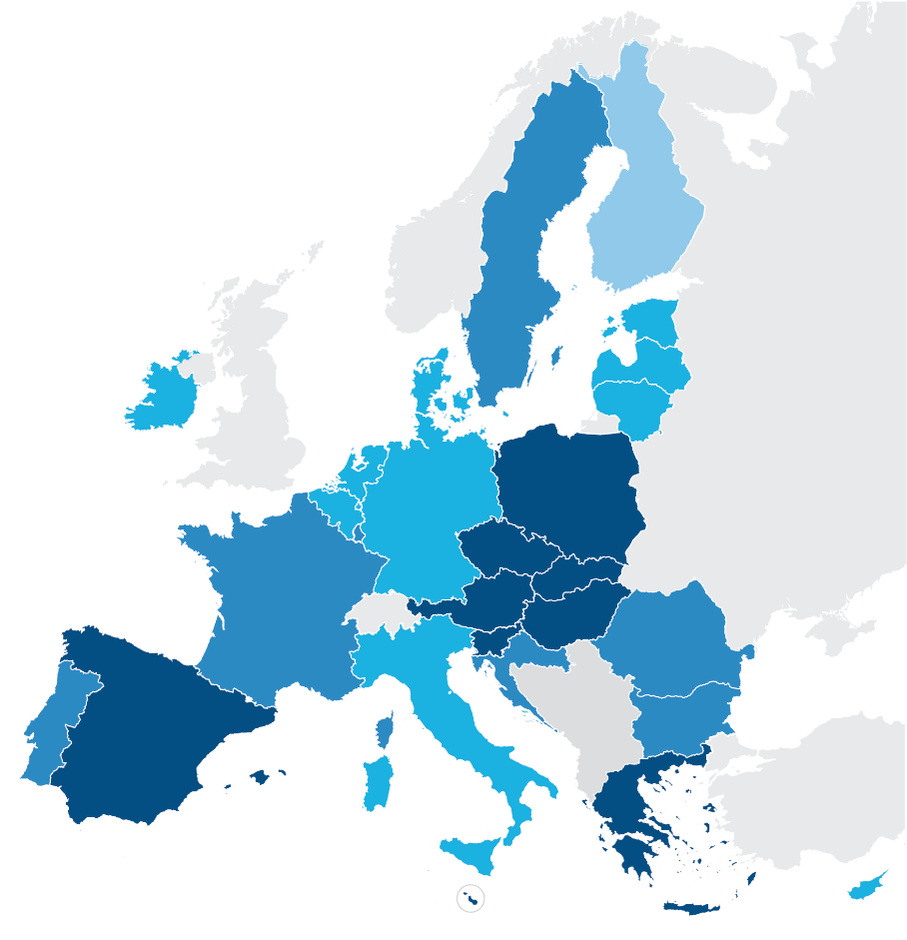
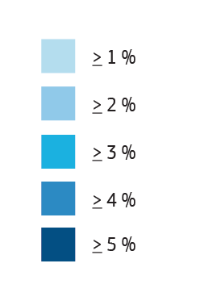
Expansion in
all Member States
2021
2022
Annual real GDP growth in %

Slide 10
Still large downside risks but there are also upsides
- New COVID-19 variants could emerge and spread more quickly
- Economic and social scars could prove deeper than thought
- Large cross-country divergences could become entrenched
+ The vaccination rollout could move more quickly than expected
+ Pent-up demand could prove stronger, coupled with innovative investments
+ The impact of Next Generation EU is only very partially factored in so far

Slide 11
Current forecast for GDP growth versus pre-pandemic forecast
EU Real GDP (2019-2022)

Slide 12
The Slovak economy and
EU‘s Recovery plan

Slide 13
Slovak economy – some light at the end of tunnel?
EC Winter 2020 Forecast – Slovak GDP: -5.9% (2020), 4.0% (2021), 5.4% (2022).
SK output to recover to 2019 levels already by end-2021, ahead of most EU Member States (chart):
- SK helped by rebound in industrial output in 2020 H2.
- Q4-20 (ESTAT): SK to record the lowest GDP contraction among Visegrad-4 (-2.7%, y-o-y)
High uncertainty and significant risks remain: pandemics development and roll-out of vaccination

Slide 14

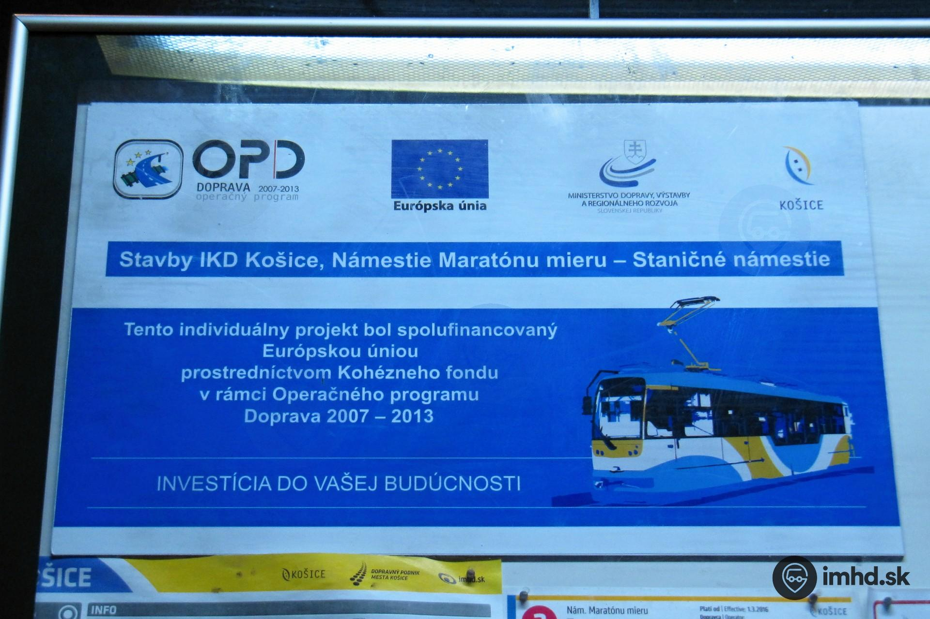
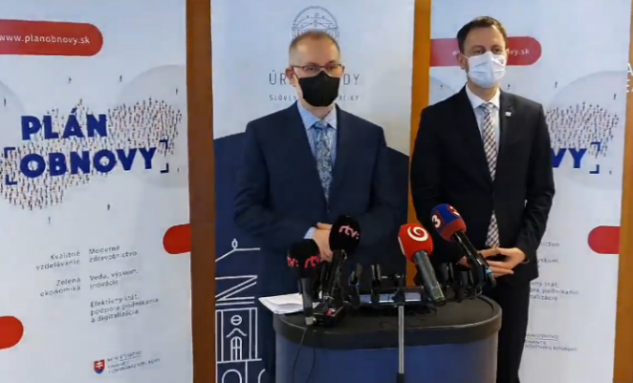

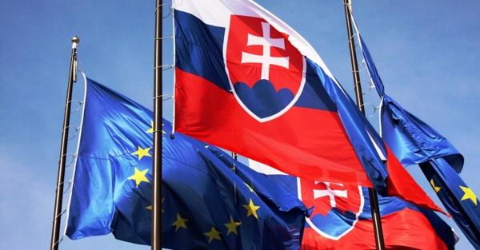
Slovak economy - challenges

Slide 15
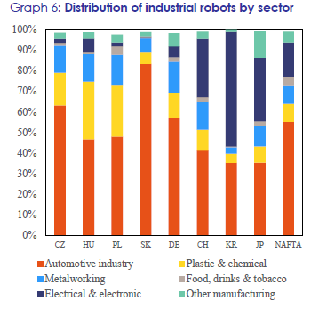
Slovakia‘s automotive – robotisation champion?

Slide 16
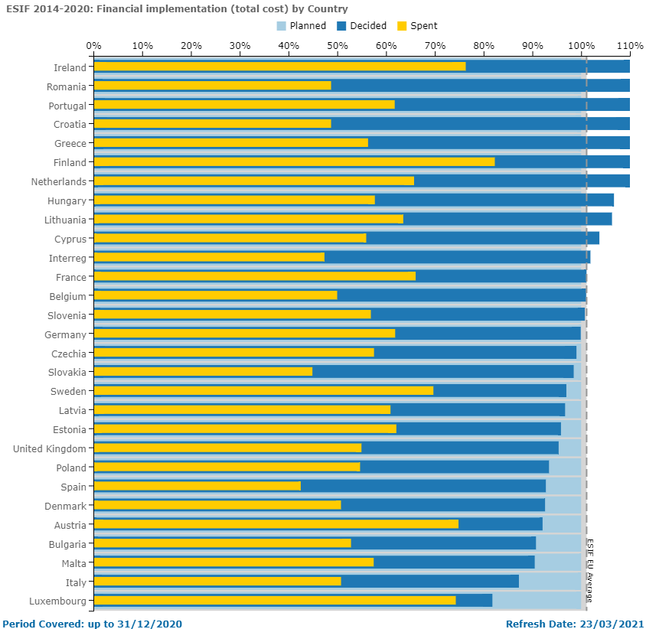
EU Structural and Investment Funds - absorption

Slide 17
Slovakia – Recovery Plan (state of play)
Grant RRF allocation for Slovakia around EUR 6bn, loans also possible.
Key areas for reforms and investments: green and digital transition, country specific recommendations
February 2021 – EP vote on the RRF Regulation (10/2) → legislation in place
Ongoing dialogue of SK with the Commission – alignment with legislative requirements/quick roll-out.
Plans to be submitted by 30 April (December 2020 and March 2021 – first and second SK draft)
Assesment of plan (EC): proposal for a Council Implementing Decision within 2 months of submission
Pre-payment 13% of the grant allocation possible already in 2021 (following the Council decision)
→ significant investment and reform boost to the Slovak economy.

Slide 18
Economic outlook for the EU and Slovakia: Why Recovery Plan?
Zdeněk Čech
Head of Economic Analyses Section
European Commission Representation in Slovakia

